Slide 1
Organizational Unit Purposes
Armani Wooden
CTEC 305
9/21/24

Slide 2
What is organizational unit?
Organizational Units (OUs) are containers within a directory service, such as Active Directory that help organize and manage resources in a network. They are used to group users, computers, groups, and other resources in a hierarchical structure, allowing for easier administration and management. OUs facilitate the delegation of administrative tasks by enabling specific permissions and policies to be applied to particular groups, enhancing security and operational efficiency. OUs simplify resource management, policy application, and organizational troubleshooting by logically structuring resources.

Slide 3
Resource organization
Logical Grouping: OUs allow organizations to logically group similar resources—such as users, computers, and applications—based on functional areas, departments, or projects. This organization helps administrators quickly locate and manage resources, improving operational efficiency and facilitating clearer oversight.
Simplified Administration: By organizing resources into OUs, administrative tasks such as applying policies, managing permissions, and enforcing security settings become more streamlined. Administrators can apply changes or updates to specific OUs without affecting the entire directory, enabling targeted management that reduces the risk of errors and enhances overall control.

Slide 4
Delegation of Administration
Enhanced Security: Delegating administrative responsibilities to specific users or groups within an OU allows for tighter security controls. By limiting access to only those who need it, organizations can protect sensitive information and reduce the risk of unauthorized actions, ensuring that only qualified personnel manage specific resources.
Operational Efficiency: Delegation enables localized management of resources, allowing department heads or team leaders to handle administrative tasks relevant to their areas. This reduces the burden on central IT and speeds up decision-making, as individuals can manage user accounts, permissions, and policies without waiting for broader administrative approval.

Slide 5
Policy Application
Tailored Security Settings: Applying group policies at the OU level allows organizations to implement specific security configurations that meet the unique needs of different departments. For example, the IT department might require more stringent security measures than a marketing team, ensuring that each group operates under the most appropriate guidelines.
Consistent Compliance and Standards: OUs enable organizations to enforce standardized policies across similar resources within the same unit. This consistency helps maintain compliance with organizational standards and regulatory requirements, making it easier to manage and audit adherence to security protocols and operational guidelines.

Slide 6

Security management
Granular Access Control: OUs enable organizations to implement fine-grained access control by allowing different security permissions for each unit. This means that sensitive information can be restricted to specific OUs, ensuring that only authorized personnel have access, significantly reducing the risk of data breaches.
Targeted Policy Enforcement: Security policies can be applied specifically to OUs, allowing for tailored security measures that address the unique risks associated with different departments. For instance, stricter password policies can be enforced in a finance OU compared to a general user OU, ensuring that security measures align with the sensitivity of the data being handled.

Slide 7

Simplified management
Streamlined Administration: OUs allow administrators to manage resources more efficiently by grouping them logically. This organization means that changes, such as applying updates or modifications to user permissions, can be executed at the OU level, reducing the time and effort required to manage individual accounts and resources.
Focused Troubleshooting: With resources organized into specific OUs, administrators can quickly identify and address issues relevant to a particular department or group. This targeted approach simplifies the troubleshooting process, enabling faster resolution of problems and minimizing disruptions to operations.

Slide 8

Scalability and flexibility
Easy Integration of New Resources: OUs provide a structured framework that allows organizations to easily add new departments, teams, or resources as they grow. This scalability ensures that new OUs can be created as the organization evolves without disrupting existing structures, maintaining an organized directory.
Adaptation to Organizational Changes: OUs offer the flexibility to reorganize or modify existing units. This adaptability allows organizations to respond to changes in business strategy, mergers, or departmental shifts, ensuring that the directory structure remains aligned with the organization’s goals and operational requirements.

Slide 9
Reporting and auditing
Enhanced Visibility and Monitoring: OUs facilitate the generation of reports that provide insights into user activities, resource usage, and compliance with security policies. This visibility helps administrators monitor behavior within specific units, making identifying potential security issues or policy violations easier.
Compliance and Accountability: By organizing resources into OUs, organizations can more effectively track and document changes, access permissions, and user actions. This structured approach supports auditing efforts, ensuring that organizations can demonstrate compliance with regulatory requirements and internal policies while also holding individuals accountable for their actions within the network.

Slide 10
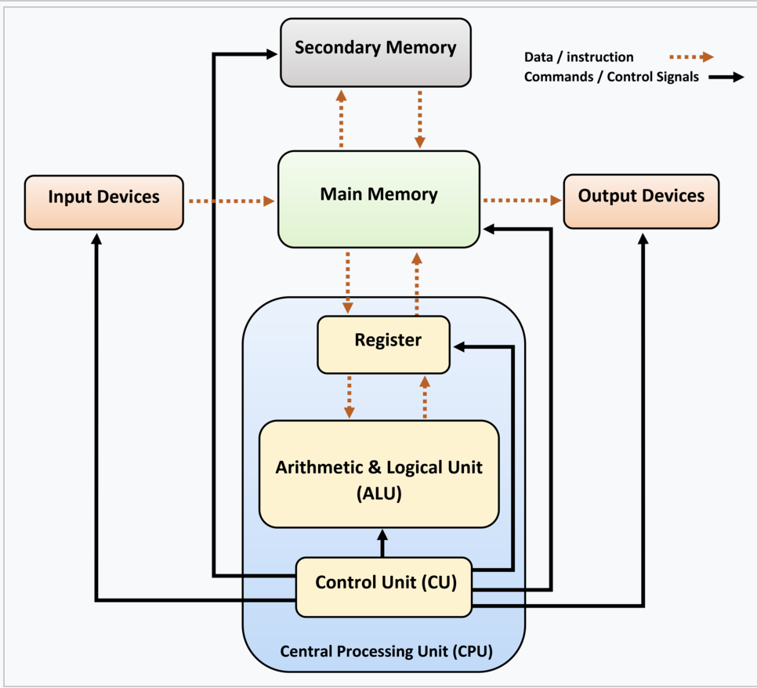
Organizational unit design

